Slide 1
BASIC NETWORKING
NETWORK
COMMUNICATION

Slide 2

OBJECTIVES FOR TODAY
Explain the role of protocols in network communication
Understanding the rules of network communication

Slide 3




ENGAGE
What elements that we need to communicate through
5 MIN
Internet ?
Notes:
Answer:
End Devices (computer, phone, tablet…)
Internet connection (you need to be online)
Network devices (AP, router, modem, switch, RJ45 cable…)

Slide 4
Communication Rules

Slide 5

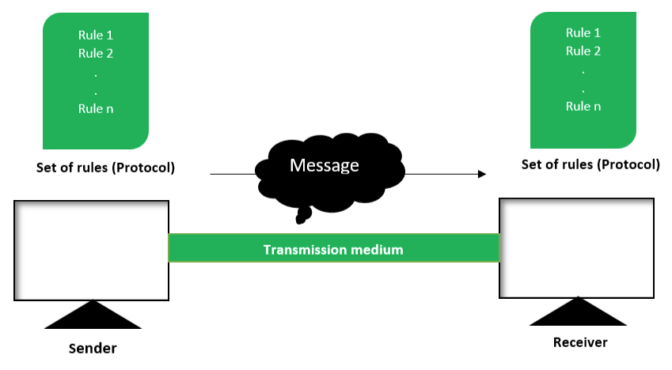
EXPLAIN
Communication Fundamentals
10 MIN
Components of Data Communication:
Message (data)
Source (sender)
Destination (receiver)
Channel (transmission medium) that provide for a path of communications to happen.
Protocol (rule)

Slide 6

EXPLORE
Communication Protocols
5 MIN
1. What method of communication should we use?
2. What langue should we use?
3. Do we need to confirm that our message are received?

Slide 7
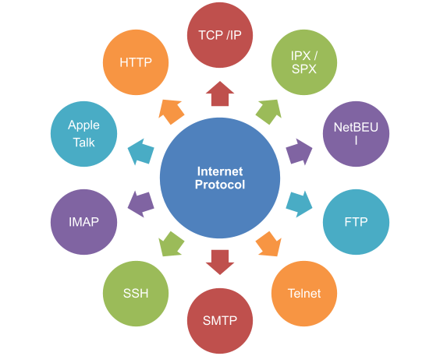

EXPLAIN
What are Protocols?
5 MIN
All communications are governed by protocols.
Protocols are the rules that communications will follow.
These rules will vary depending on the protocol.

Slide 8
EXPLAIN
Rule Establishment Requirements
5 MIN
Individuals must use established rules or agreements to govern the conversation.
These rules or protocols, must be followed for the message to be successfully delivered and understood:
An identified sender and receiver
Common language and grammar
Speed and timing of delivery
Confirmation or acknowledgment requirement
Notes:
- This is the rules for simple communication.

Slide 9
Network Protocol Requirements
Notes:
Questions for engagement:
How video call is works?
How can we send a picture from a phone to another phone through massager?
How live streaming works?

Slide 10
EXPLAIN
Network Protocol Requirement
5 MIN
Network protocols must be in agreement and include the following requirements:
Message encoding/decoding
Message formatting and encapsulation
Message size
Message timing
Message delivery option
Notes:
- This is the rules for simple communication.

Slide 11
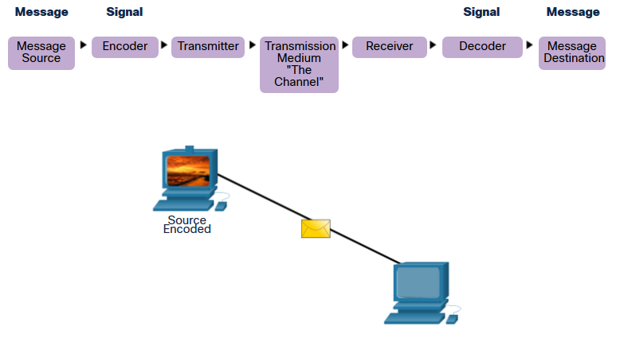
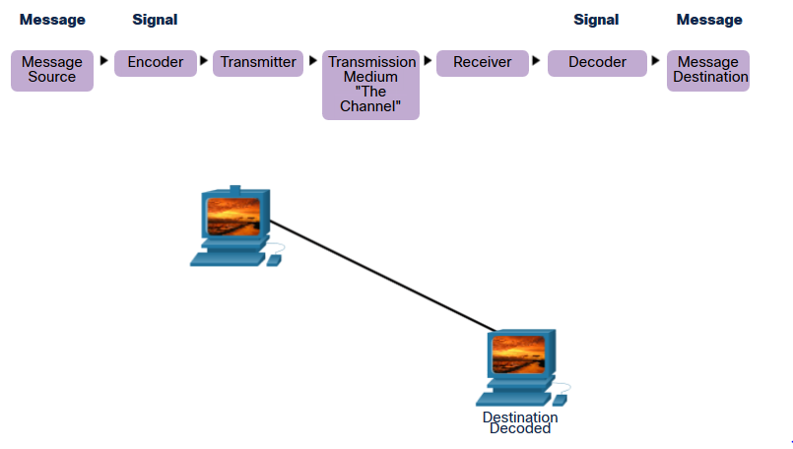
Network Protocol Requirement

Slide 12

ACTIVITY
ACTIVITY 1
5 MIN
Role play : network communication
Notes:
Ask student to work in group to do the role play of network communication. The communication about sending Mail.
Roles:
Sender: create message
POST office
Delivery
POST Office
Receiver: Open message

Slide 13
Protocol Suites

Slide 14
EXPLORE
Can computer do the difference communication at a time?
5 MIN
Do we use only one protocol to complete the communication?
What type of protocols?

Slide 15
EXPLAIN
Types of Protocol in Computer Network
5 MIN
There are main three types of protocols in computer network:
Communication Protocols
Management Protocols
Security Protocols
IP TCP UDP HTTP DNS IMAP POP
SNMP SMTP
SSL SSH VPN
Notes:
- This is the rules for simple communication.

Slide 16
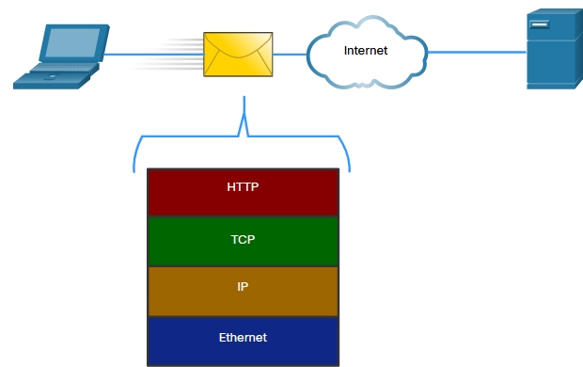
EXPLAIN
Network Protocol Suites
5 MIN
Protocol must be able to work with other protocols. Successful communication between hosts requires interaction between a number of protocols.
The protocols in the figure are described as follows:
HTTP – This protocol manage the way a web server and a web client interact.
TCP – This protocol is guaranteeing the reliable delivery of the information between the end devices.
IP – This protocol is responsible for delivering messages from the sender to the receiver.
Ethernet – This protocol is responsible for the delivery of messages from one NIC to another NIC.
Notes:
https://whatismyipaddress.com/isp
https://www.geeksforgeeks.org/isp-full-form/
https://kinsta.com/knowledgebase/what-is-isp/
https://www.youtube.com/watch?v=93-3zmVvCGU

Slide 17
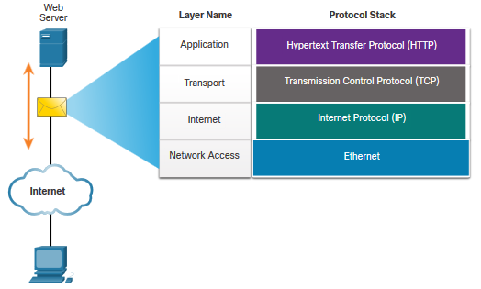
EXPLAIN
Network Protocol Suites
5 MIN
Protocol suite:
A group of inter-related protocols necessary to perform a communication function
Sets of rules that work together to help solve a problem
TCP/IP Protocol Suit Example
TCP/IP protocols operate at the application, transport, and internet layers.

Slide 18
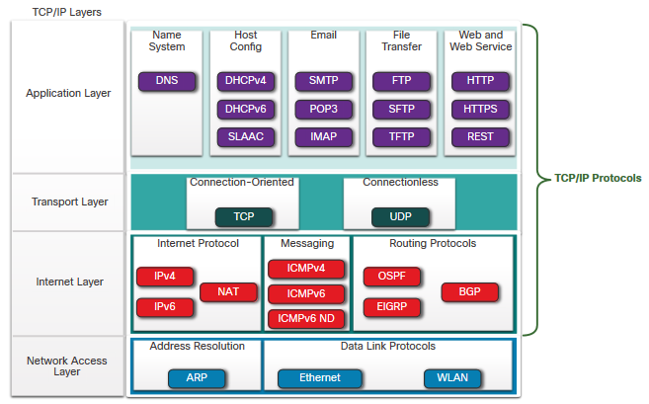
EXPLAIN
TCP/IP Protocol Suite
5 MIN
TCP/IP is the protocol suite used by the internet and includes many protocols.
TCP/IP is:
An open standard protocol suite that is freely available to the public and can be used by any vendor
A standards-based protocol suite that is endorsed by the networking industry and approved by a standards organization to ensure interoperability

Slide 19
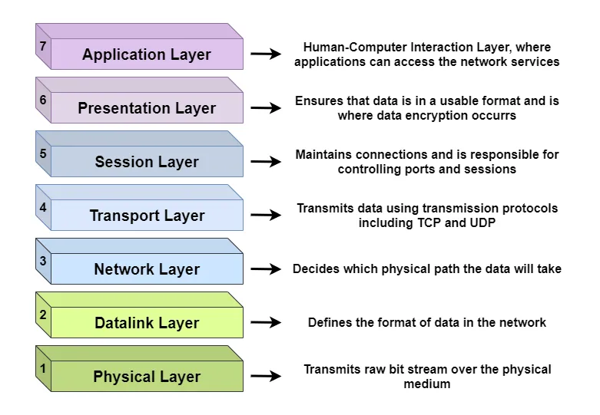
EXPLAIN
OSI Model Layer
5 MIN
The Open Systems Interconnection (OSI) model describes seven layers that computer systems use to communicate over a network.
Notes:
https://whatismyipaddress.com/isp
https://www.geeksforgeeks.org/isp-full-form/
https://kinsta.com/knowledgebase/what-is-isp/
https://www.youtube.com/watch?v=93-3zmVvCGU

Slide 20


